Slide 1



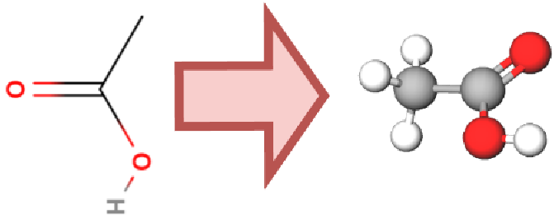
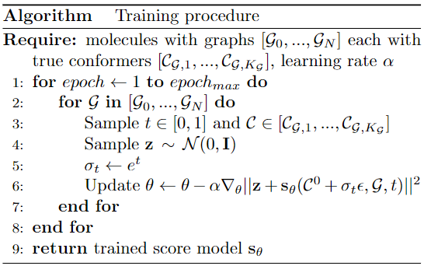
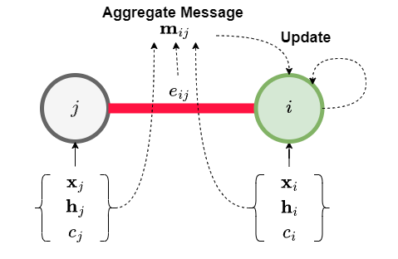
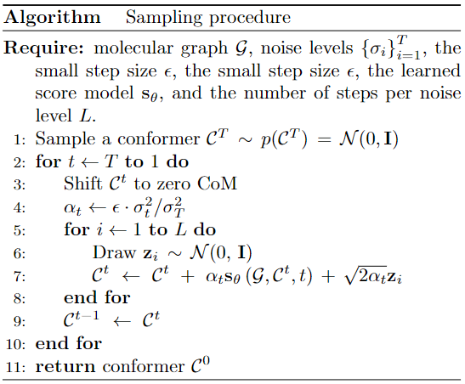
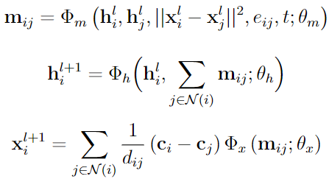
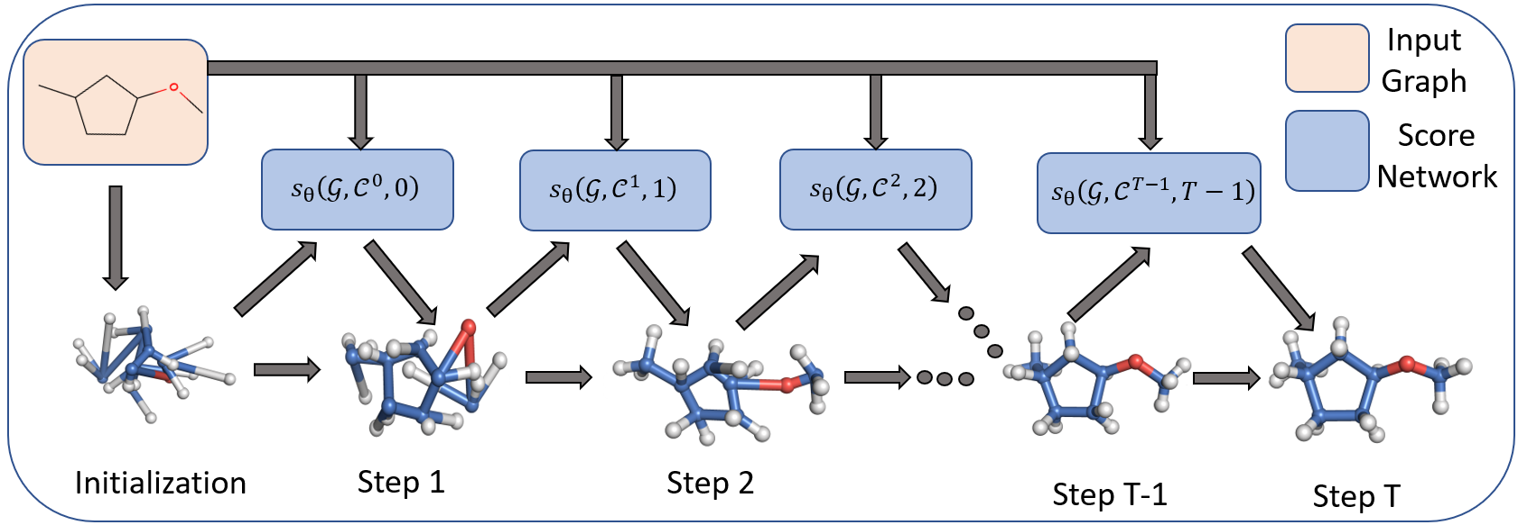
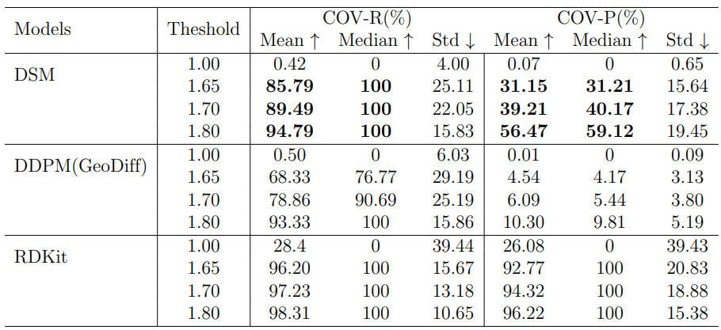
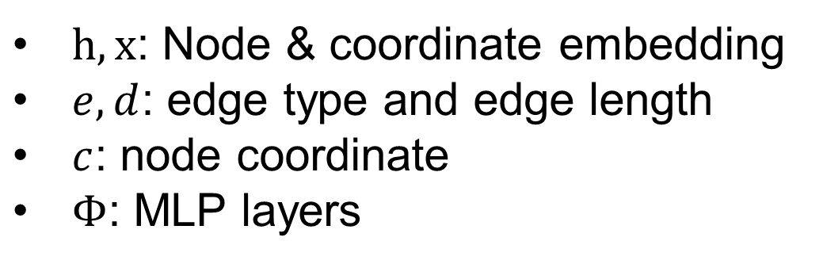
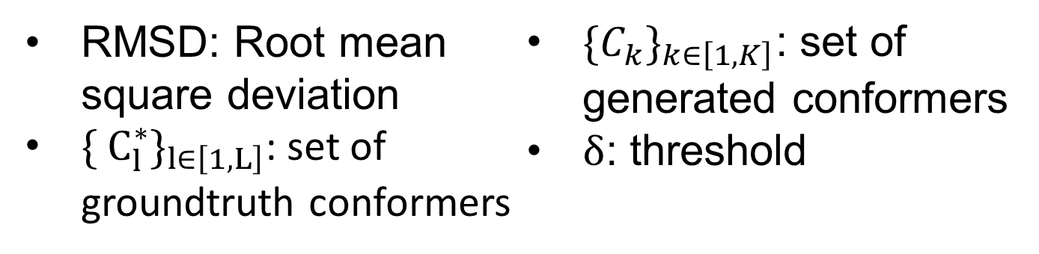
VIETNAM NATIONAL UNIVERSITY UNIVERSITY OF TECHNOLOGY FACULTY OF COMPUTER SCIENCE AND ENGINEERING CAPSTONE PROJECT REPORT
Group : Drug Discovery - AI4Science
Student : Dang Cao Cuong
Student ID : 1952598
Diffusion Model for Conformer Generation
Instructor: Assoc. Prof Quan Thanh Tho, PhD
Introduction
Demo
Personal Info
Hình ảnh
A conformer is a 3D structure of a molecule and conformer generation is the process of predicting or generating the three-dimensional structure of molecules given their graph, including graph structure, node type, and edge type. Graph structure is the connectivity between nodes of a molecule. Node types and edge types are labeled based on the types of atoms and bonds in a molecule. For example, the image on the left shows that a conformer of the acetic acid molecule is formed given its graph.
Problem Statement/Challenges
Training & Sampling
GNN Architecture
Conformer generation: an important task in several scientific fields, such as bioinformatics, pharmacology, etc.
Biocomputational method: accurate but time-consuming when dealing with large molecular graphs
ML methods: difficult to find a suitable GNN architecture for spatiotemporal data commonly used to model 3D structures of molecules in space
→ A stable, fast, diverse, and accurate method is critical
$h,x$: Node & coordinate embedding
$e, d$: edge type and edge length
$c$: node coordinate
$Φ$: MLP layers
Research Method
Design ML method to learn the probability distribution of conformers given their graphs
Propose a score-based diffusion model (SDM) which utilizes the score-based function to approximate small trajectories mapping from a tractable distribution, such as a Gaussian distribution, to the distribution of conformers
Advantage: small mapping trajectories → easier for GNN to learn the trajectories
Baseline: two SOTA methods, GeoDiff (ML method) & RDKit (biocomputational method)
Dataset
GEOM dataset: 37 million conformers
133,000 species from QM9 and 317,000 species with experimental data related to biophysics, physiology, and physical chemistry
Focus on GEOM-QM9, a medium part of GEOM
Total size: 3.65GB with 133,254 files
Metrics
Figure: Generation procedure of the system via Langevin dynamics.
RMSD: Root mean square deviation
$\{ C_{l}^{∗}\}_{l∈\left[1,L\right]}$: set of groundtruth conformers
$\{C_{k}\}_{k∈\left[1,K\right]}$: set of generated conformers
$δ$: threshold
Conclusion
The DSM method gives better results than the DDPM method used in GeoDiff in terms of both metrics, COV-R and COV-P. In terms of mean, the DSM method gives about 25% better results on the COV-R metric and 6.8 times better on the COV-P metric with a threshold of 1.65. Although RDKit biocomputational method has slightly better results than DSM, in practice RDKit method skips 5/200 conformers due to failure to generate a conformer. In brief, the proposed method is the most appropriate one for tasks in the drug discovery industry such as creating a large number of conformers which requires fast, stable, diverse, and accurate conformer generation.
Results
Mô tả
Future Work
Table: The results of conformer generation when applying RDKit, DSM, and DDPM with thresholds of 1.0, 1.65, 1.7 and 1.8
Apply a new generative model
Use more expressive GNNs
Inspect the latent space
Replace GNNs with LLMs
Generate rotatable bonds

